Slide 1

Research Paper Recommendation System CMPE-256 Group Project
Team No. 8
Purva Deekshit (013749723)
Shreya Halagahalli Shrinivas (013821405)
Maulin Bodiwala (013733590)
Kiran Kumar Bijjala (013772551)
Siddartha Reddy Maryada (013849238)

Slide 2
Motivation
Provide researchers with useful publications at any time, place and form.
Offer the right publication to the right researcher in an efficient way.
Save time spent on looking for relevant research papers.

Slide 3
Classical Approaches and Challenges
Fetch query asking to provide specific information.
Follow a list of references from already referenced papers. Does not guarantee full coverage of research papers.
Insufficient in tracing papers published after the referenced papers.
List of references may not be publicly available and hard for researchers to access.

Slide 4
Our Approach
Hybrid Recommendation:
Provide more accurate and relevant recommendations.
Combination of collaborative and content-based filtering.
Recommender systems incorporate users’ contexts and possible contextual information.
User information for content-based filtering.
Similarity score between keywords for collaborative filtering.

Slide 5
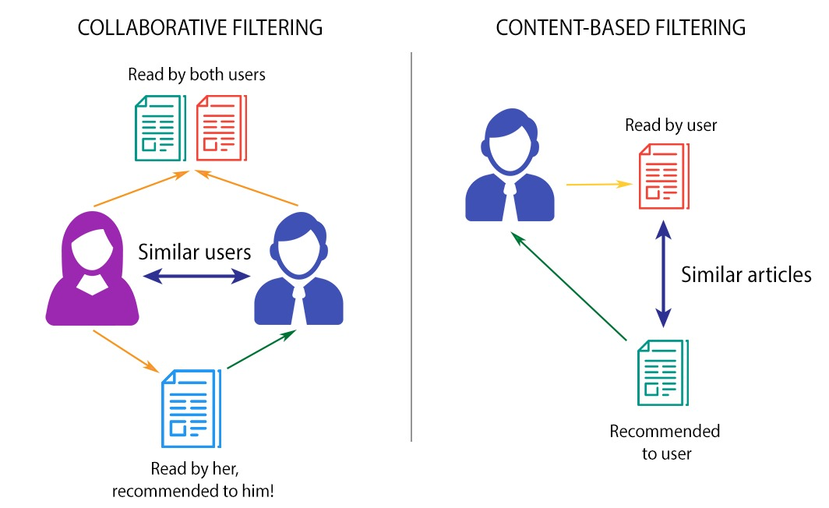
Hybrid Recommendation
Hybrid Recommendation System

Slide 6








Flow Diagram of Hybrid Approach
Query user information and research paper title
Search user in database
Identify the previous referenced papers
Get keywords from summary of previous papers using TF-IDF and compare with summary of other papers using content based filtering
Get similar users who have referenced similar papers
Calculate candidate score of each paper and each user
Recommend top N papers to the user

Slide 7
Research Paper Data Collection
Research paper metadata collected from arXiv website using arXiv APIs.
Link: https://arxiv.org/help/api#documentation
Paper Metadata :
Data is pulled for multiple categories.
For example: cs.AI, cs.CE, cs.SE, cs.GR, cs.NI, cs.DB.
Sample fields: title, authors, summary, primary category, affiliation, journal reference, doi, etc.

Slide 8
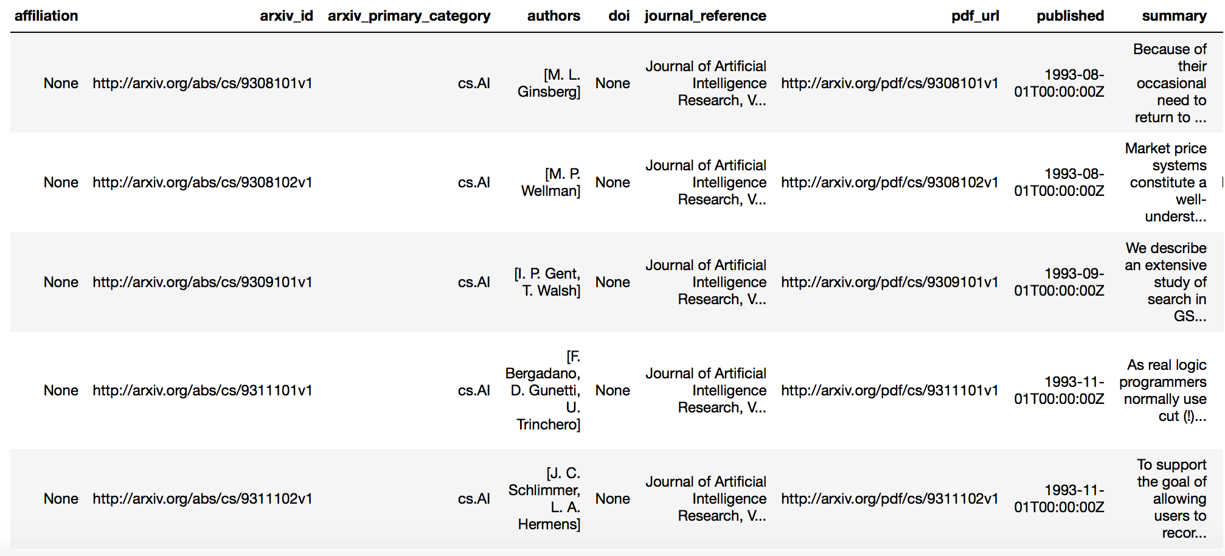
Research Paper Data Collection
Sample paper data after scrapping:

Slide 9
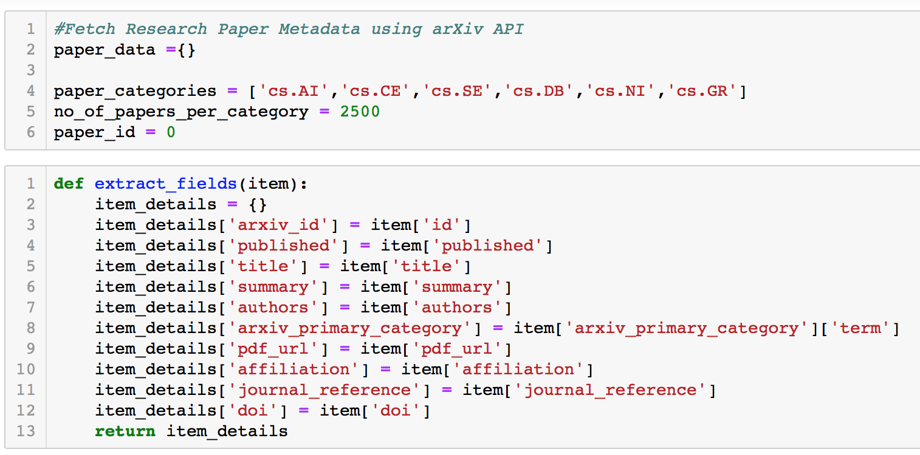
Research Paper Data Collection
Code snippet for fetching paper data:

Slide 10
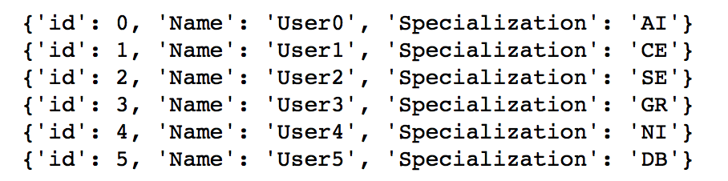
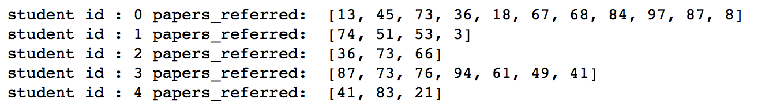
User Data Simulation
User data :
User data was unavailable. Simulated users as students from AI, CE, SE, GR, NI and DB specialization.
Sample students data:
Student-to-paper mapping :
Randomly assigned papers to each student indicating papers referenced by the student.
Sample mapping:

Slide 11
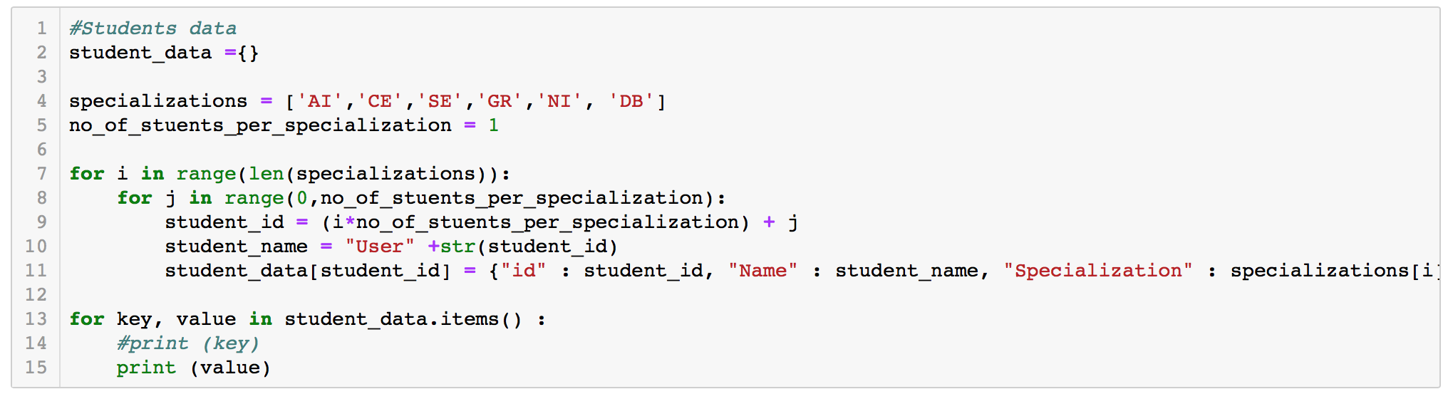
User Data Simulation
Code snippet for generating user data:

Slide 12
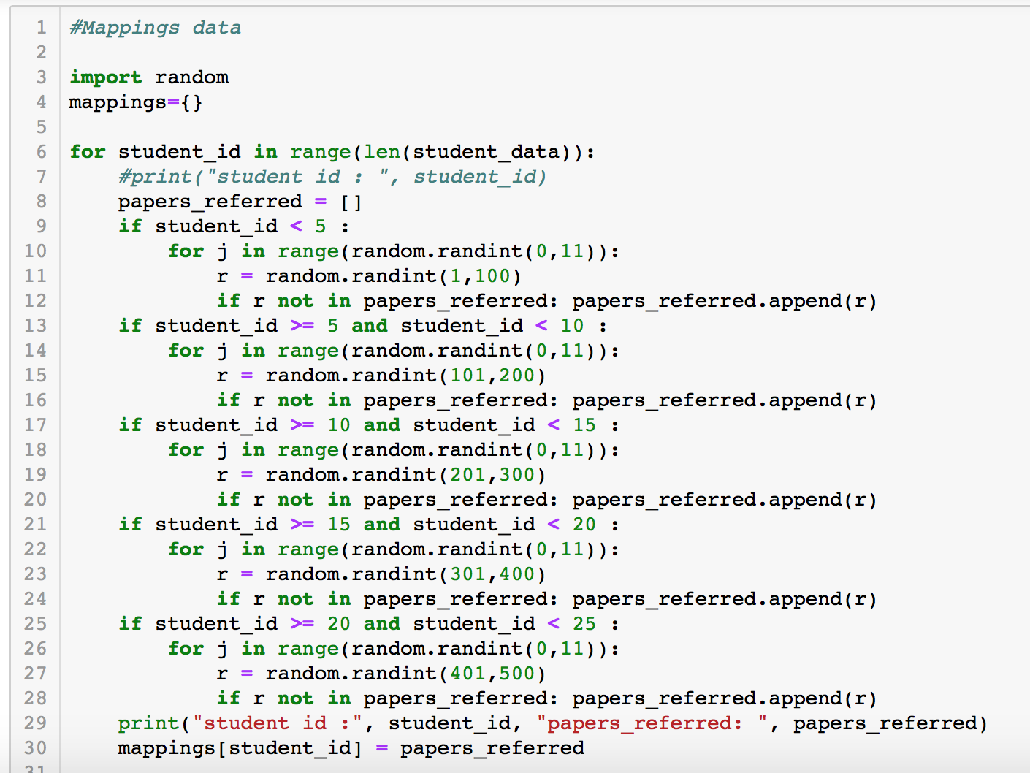
User Data Simulation
Code snippet for user-to-paper mapping:

Slide 13
Data Analysis
Remove missing values.
Remove duplicate values.
Gather statistics of students/papers.
Analyze students for each specialization with certain overlapping courses to get common papers.

Slide 14
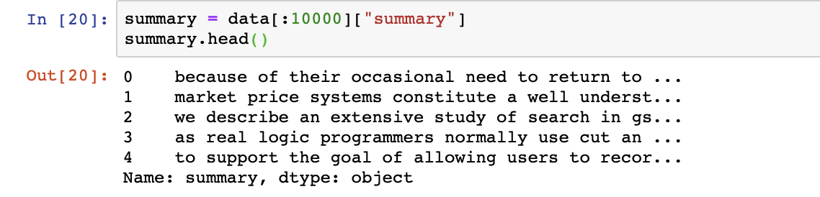
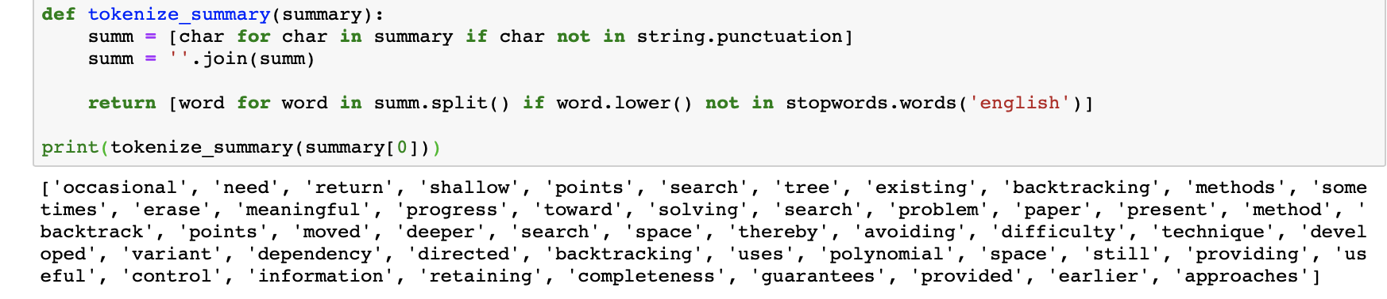
Data Pre-processing
Preprocessing steps:
Consider “Summary” column for calculating similarity between papers.
Remove “Stopwords” using NLTK.
Use TF-IDF to most and least occurring words.

Slide 15
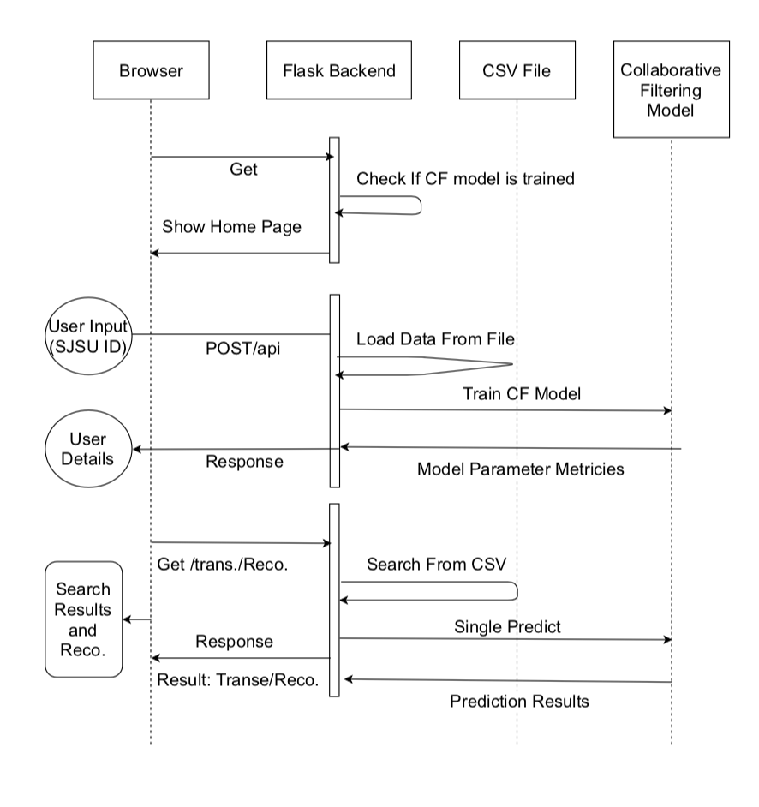
Workflow
Workflow:

Slide 16
Implementation
Similarity between papers:
Natural Language Processing
Word Tokenizer and Sentence Tokenizer
Word embeddings like Word2Vec using Bag-of-Words or N-grams model
Similarity between users:
Memory based approach:
- Cosine Similarity
- Pearson’s Correlation
Model based approach:
- Factorization matrix
- Neural network for predicting user preferences

Slide 17
Evaluation
To be presented in final report.

Slide 18
Thank You

